Slide 1

NLP: Recurrent Neural Network
Video 1: Understanding RNN

Slide 2
In Air

Slide 3

Suggest the game based on review.
“This game is bad.”

Slide 4

Recurrent Neural Network

Slide 5
Understanding RNN
RNN processes sequences one 'time step' at a time; each word is a step
Time step 2
Time step 4
“ This game is bad.”
Time step 1
Time step 3

Slide 6
Understanding RNN
RNN processes sequences one 'time step' at a time; each word is a step
“ This game is bad.”
Time step 1

Slide 7
Understanding RNN
RNN processes sequences one 'time step' at a time; each word is a step
Time step 2
“This game is bad.”
Output from previous time step

Slide 8
Understanding RNN
RNN processes sequences one 'time step' at a time; each word is a step
Time step 4
“This game is bad. ”
Outputs from previous time steps

Slide 9
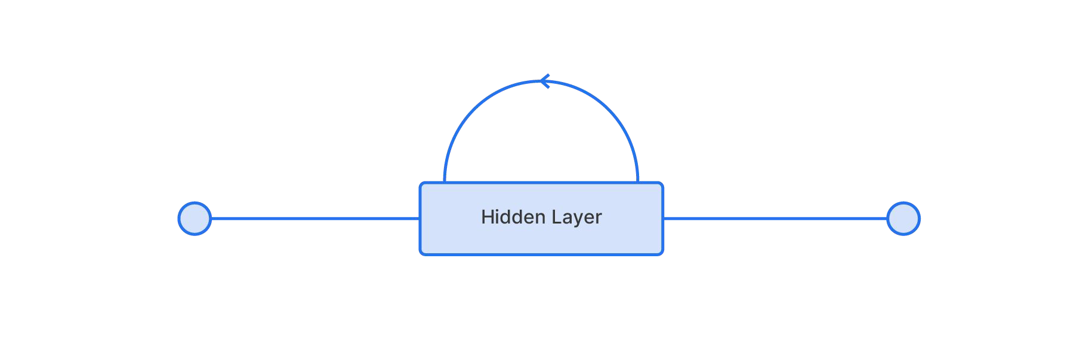
RNN With One Hidden Layer

Slide 10
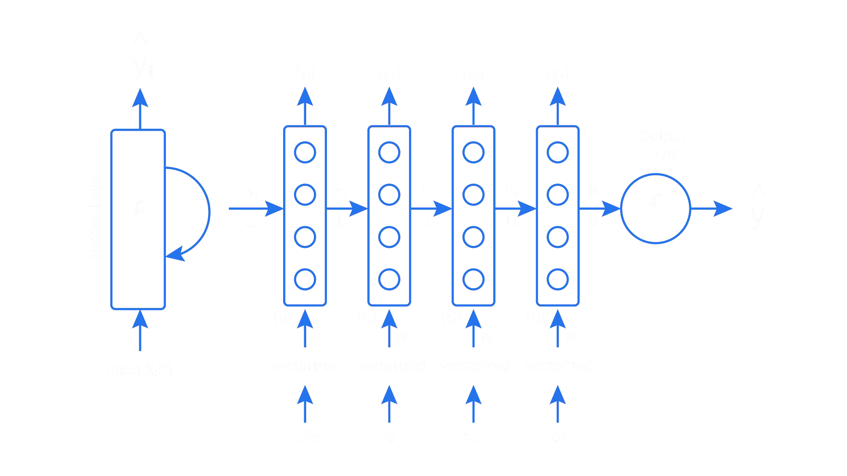


RNN With One Hidden Layer
y_{t}
w_{h}
w_{h}
w_{h}
w_{h}
w_{y}
x
x
x
x
x
This game is bad
Input (X_{t})

Slide 11
RNN With One Hidden Layer
y_{t}
Output Layer
Hidden Layer
w_{h}
w_{h}
w_{h}
w_{h}
w_{y}
x
x
x
x
Input Layer
This game is bad
Input (X_{t})

Slide 12
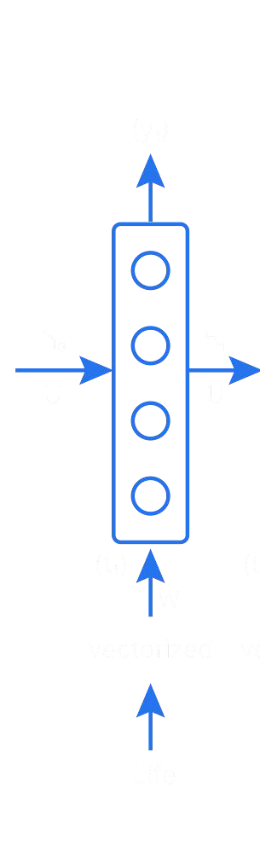

RNN With One Hidden Layer
Time Step 1:
w_{h}
This
(x₁)

Slide 13
RNN With One Hidden Layer
Time Step 1:
w_{h}
W_{x}
X₁ * W_{x}
This
(x₁)

Slide 14
RNN With One Hidden Layer
Time Step 1:
w_{h}
Bias (b_{h})
W_{x}
X₁ * W_{x} + b_{h}
This
(x₁)

Slide 15

RNN With One Hidden Layer
Time Step 1:
Information from previous time step h_{t}
w_{h}
W_{x}
X₁ * W_{x} + b_{h}
This
(x₁)

Slide 16
RNN With One Hidden Layer
Time Step 1:
h₀ = [0,0,...,0]
w_{h}
W_{x}
X₁ * W_{x} + b_{h}
This
(x₁)

Slide 17
RNN With One Hidden Layer
Time Step 1:
X₁ * W_{x} + h₀ * W_{h} + b_{h}
w_{h}
W_{x}
This
(x₁)

Slide 18
RNN With One Hidden Layer
Time Step 1:
h₁ = A ( x₁ * W_{x} +h₀ * W_{h}+ b_{h} )
w_{h}
ReLu, Tanh, etc.
W_{x}
This
(x₁)

Slide 19
RNN With One Hidden Layer
Time Step 1:
Weight matrix connecting input X to the neural network
h₁ = A ( x₁ * W_{x} + h₀ * W_{h}+ b_{h} )
w_{h}
Weight matrix connecting previous hidden states
W
x
This
(x₁)

Slide 20
RNN With One Hidden Layer
Time Step 1:
Bias (b_{y})
y₁= A’ ( h₁ * W_{y} + b_{y} )
Output Layer
w_{y}
w_{h}
h₁ = A ( x₁ * W_{x} + h₀ * W_{h}+ b_{h} )
W_{x}
This
(x₁)

Slide 21
RNN With One Hidden Layer
y₁= A’ ( h₁ * W_{y} + b_{y} )
Output Layer
w_{y}
w_{h}
W_{x}
This
(x₁)

Slide 22
RNN With One Hidden Layer
y_{t}= A’ ( h_{t} * W_{y} + b_{y} )
Output Layer
w_{y}
Quality Gender Emotion
-0.16
-0.05
1.08
w_{h}
Power Enthusiasm
6.56
2.45
W_{x}
This
(x₁)

Slide 23
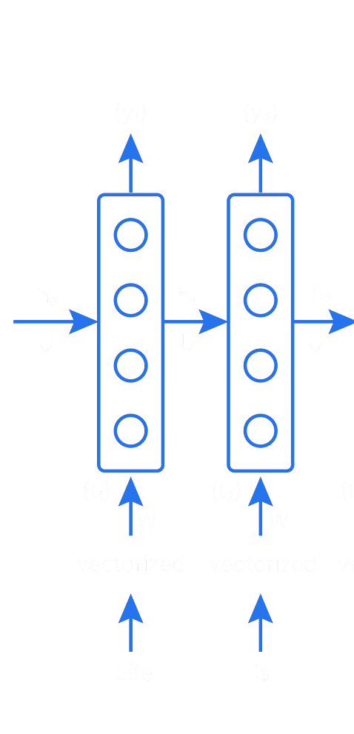
RNN With One Hidden Layer
Time Step 2:
w_{h}
w_{h}
w_{h}
h₂ =
W_{x}
W_{x}
(x₁)
game ^{(x2)}
This
(x₂)

Slide 24
RNN With One Hidden Layer
Time Step 2:
w_{h}
w_{h}
w_{h}
h₂ = X₂ * W_{x}
W_{x}
W_{x}
Weight matrix connecting input X to the neural network
(x₁)
game ^{(x2)}
This
(x₂)

Slide 25
RNN With One Hidden Layer
Time Step 2:
w_{h}
w_{h}
w_{h}
h₂ = A( x₂* W_{x} + h₁ * W_{h} + b_{h} )
W_{x}
Weight matrix connecting previous hidden states
W
x
Bias (b_{h})
(x₁)
game ^{(x2)}
This
(x₂)

Slide 26
RNN With One Hidden Layer
Time Step 2:
y₂= A’ ( h₂ * W_{y} + b_{y} )
w_{h}
w_{h}
w_{h}
h₂ = A( x₂* W_{x} + h₁ * W_{h} + b_{h} )
W_{x}
W_{x}
Bias (bh)
(x₁)
game ^{(x2)}
This
(x₂)

Slide 27
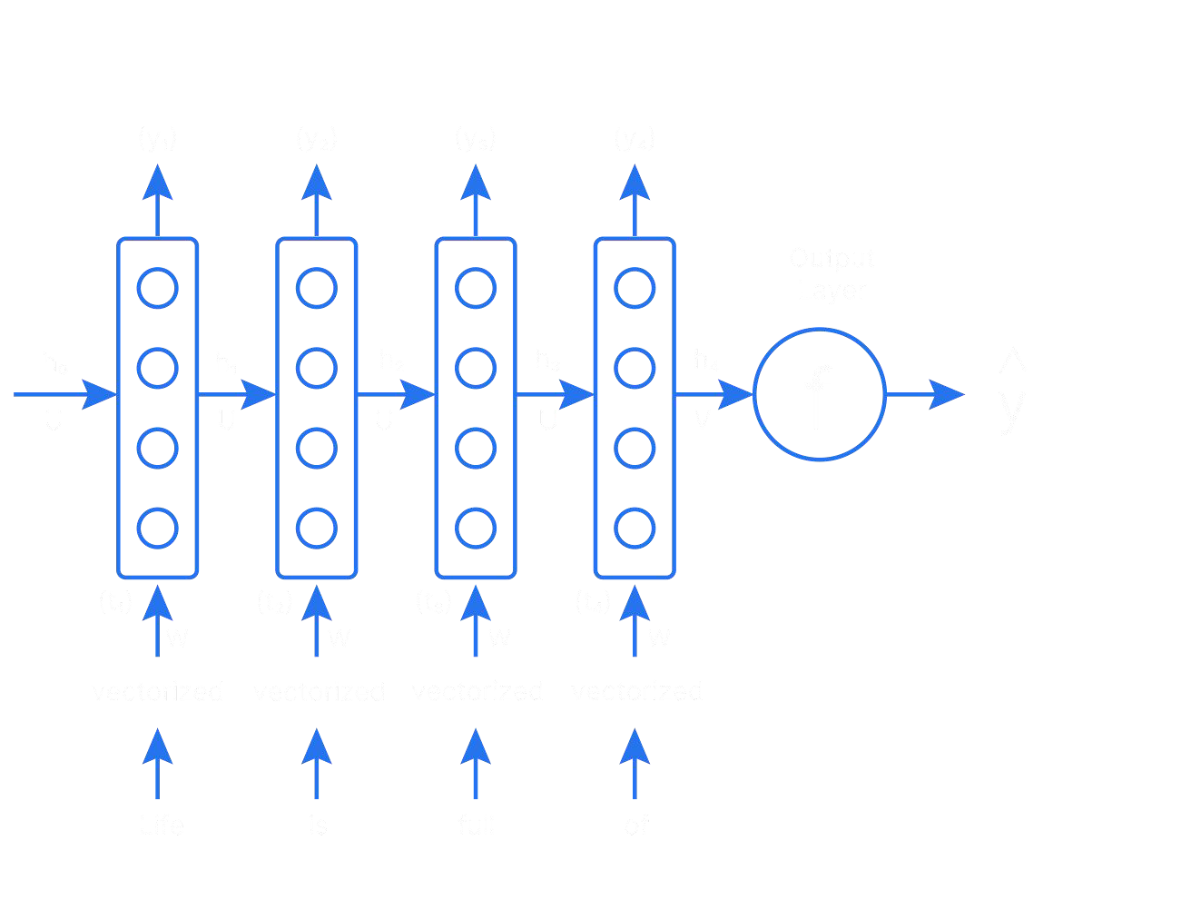

RNN With One Hidden Layer
Time Step 3 & 4:
y₃= A’ ( h₃* W_{y} + b_{y} )
y_{t}
w_{y}
w_{y}
w_{y}
w_{y}
y₄= A’ ( h₄ * W_{y} + b_{y} )
w_{h}
w_{h}
w_{h}
w_{h}
h₃ = A ( x₃* W_{x} + h₂ * W_{h} + b_{h} )
x
x
W_{x}
W_{x}
h₄ = A ( x₄* W_{x} + h₃ * W_{h}+ b_{h} )
Input (X_{t})
This game is bad

Slide 28
RNN With One Hidden Layer
Formula :
Hidden state at time step t
h_{t} = A (X_{t} * W_{x} + h_{t-1} * W_{h} +b_{h})
y_{t} = A’ ( h_{t} * W_{y} +b_{y})
Output at time step t

Slide 29
RNN With One Hidden Layer
y_{t}
w_{y}
w_{y}
w_{y}
w_{y}
w_{h}
w_{h}
w_{h}
^{w}hx
x
x
W_{x}
W_{x}
Input (X_{t})
This game is bad

